Slide 1
Lecture 6
Analyzing Risk: Dealing with Correlated Data

Slide 2
Learning Objectives
After you complete this lecture, you will be familiar with the following concepts:
Pearson product moment correlation
Spearman rank correlation
Computing Pearson product moment correlation and Spearman rank correlation in R
Incorporating a correlation matrix into an R model
Impact of correlation on the decision-making process

Slide 3
Zappos' Problem
In the first part of this module, we will be working with the following problem:
Zappos is a retailer of women's clothing, accessories, and beauty products. Suppose that the regional purchasing manager for Zappos is in the process of determining the order quantities for a new product line of women's sleepwear for the upcoming holiday season. The new product line consists of four types of pajamas: cotton, flannel, silk, and velour. An initial order quantity of 10,000 of each type of pajama has been proposed, but we want to evaluate this decision with a simulation model. We are given the following data for this problem.

Slide 4
Zappos' Problem
 | Cost | Selling Price | Discount Price
Cotton | $25 | $30 | $10
Flannel | $25 | $40 | $10
Silk | $35 | $60 | $30
Velour | $30 | $55 | $20
The cotton and the flannel pajamas are similar to other products that Zappos has sold in the past. The marketing department has compiled representative samples of cotton and flannel pajama demand as shown in Figure 6.1.
The silk pajama's design is different from that of all other Zappos' existing products, therefore the marketing department does not believe that we should use past data to model the demand of silk pajama. However, the marketing department has conducted extensive surveys to estimate the likely demand scenarios for silk pajamas and obtained the following information:

Slide 5
Zappos' Problem
In addition, Zappos estimates a maximum silk pajama demand of 30,000 and a minimum possible demand of 0.
The velour pajama is a new product being introduced this season. Therefore, we cannot use past data to model it and the only information that we have is the minimum, most likely, and maximum values of velour pajama demand, which are 2500 units, 10,000 units, and 25,000 units, respectively.
Source: Camm et al., Essentials of Business Analytics, 2015, Cengage Learning, pp. 506-514
Values | Demand
5,000 | 0.1
10,000 | 0.4
15,000 | 0.2
20,000 | 0.25
25,000 | 0.05

Slide 6
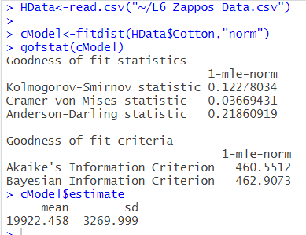
Modeling the cotton pajama demand
The historical data for cotton pajama demand is given in Figure 6.1 We now use the fitdistrplus package to find a distribution that fits our cotton pajamas nicely. After trying several distributions, we might settle on the normal distribution. We use the fitdist function to create a normal model from our data and the gofstat function to display goodness of fit statistics about it. Both of these are from the “fitdistrplus” library. The code for this is reproduced in figure 6.2

Slide 7
Modeling the cotton pajama demand
The demand for pajamas is indeed a discrete random variable. However, a typical practice to model the demand is to use a continuous distribution (as discussed in Lecture 5). As the numbers a discrete random variable can take on get larger, continuous distributions become stronger approximations.
We observe a KS statistic of .12, which, while not perfect, is OK for our purposes. Since our sample is relatively small, random noise in the data makes it very unlikely to find any strong fit for our data.
We also want to make sure that “out of bounds” values, in this case, demand values less than 0, won’t pop up in our simulations. We see the mean is approximately six standard deviations higher than 0. We’ll almost never encounter a trial with demand lower than 0 under such circumstances.

Slide 8
Modeling the flannel pajama demand
After trying out different distributions, we eventually settle on the Weibull distribution to model flannel pajama demand.
INDIVIDUAL EXERCISE
Try “shifting” the distribution by subtracting or adding values to the data set before fitting it. Can you get a better fit than we use in this lecture?
We again produce a model, along with parameter estimation and fit statistics, reproduced in Figure 6.3.
The fitdistrplus library makes it very easy to do graphical fit tests of our distributions as well. In figure 6.4, we compare the compare the cdf and pdf of our fitted distribution to that of our data, and produce qq and pp plots as well.

Slide 9
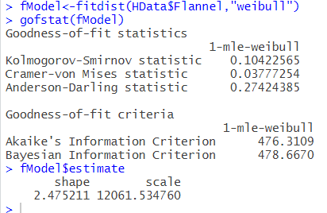
Modeling the flannel pajama demand
INDIVIDUAL EXERCISE
Check the examples provided in the documentation for fitdistrplus to see how to compare multiple potential fits at once.

Slide 10

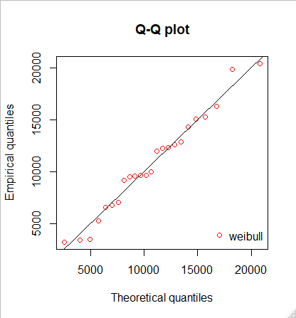
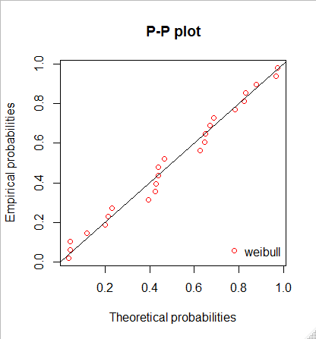
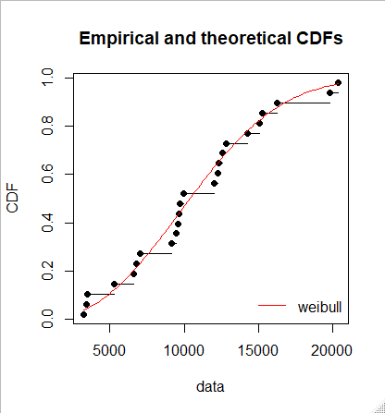
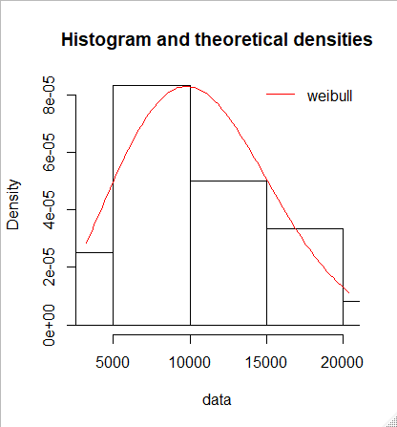
Modeling the flannel pajama demand

Slide 11
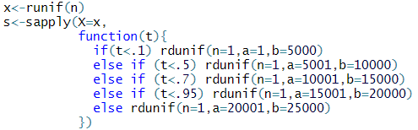
Modeling the silk pajama demand
The demand for silk pajamas is provided directly by the problem. We use the breakpoints method defined in the previous lecture to handle this. The code for this can be seen in Figure 6.5.

Slide 12
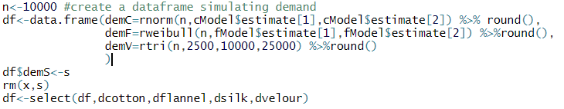
Modeling the velour pajama demand
We use a triangular distribution to model demand for velour pajamas, as the problem only specifies a minimum, maximum, and most likely value. We combine all four demands into one data frame in Figure 6.6, reordering them alphabetically.

Slide 13
Model Output
We now study the output of the model by computing the profit, using the table from the statement of the problem to determine costs and revenues. The code for this, as well as a histogram representing profits, and the mean and standard deviation, are provided in Figure 6.7.

Slide 14
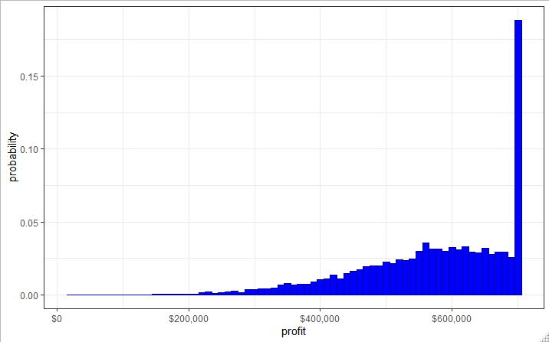
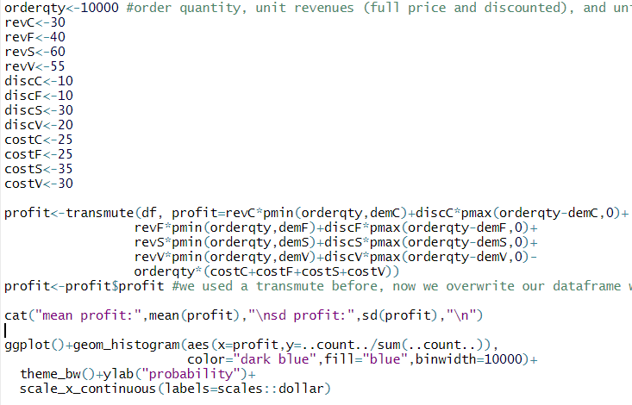
Model Output

Slide 15
Correlation Among the Inputs
Suppose that the market research has suggested that the cotton and flannel pajamas are often substitutes. In other words, customers buy either one or another. Therefore, if the demand for one of them is high, we expect the demand for the other to below.
Research also suggests that the demand of silk and velour pajamas is negatively correlated with an estimated correlation of –0.5.
Cotton pajama demand is positively correlated with both silk and velour pajamas with a correlation of 0.25.
Correlation between flannel and velour pajamas is estimated to be 0.25.
Correlation between flannel and silk pajamas is estimated to be 0.
Source: Adapted from Camm et al., Essentials of Business Analytics, 2015, Cengage Learning, p. 538 and p. 540.

Slide 16
Pearson Product Moment Correlation
Pearson product moment correlation is the most widely used correlation measure It measures the strength of linear relationship between two random variables. It takes values between –1 and 1. A Pearson product moment correlation of –1 denotes a strong negative relationship between a pair of random variables, while a Pearson product moment correlation of +1 denotes a strong positive relationship between a pair of random variables. A Pearson product moment correlation close to 0 indicates the absence of linear relationship between a pair of random variables.

Slide 17
Pearson Product Moment Correlation
We are given the information that the cotton and flannel pajamas are often substitutes but we are not given any information about the degree of their correlation. However, given the historical data of cotton and flannel pajamas, we can visually check their relationship to one another. We do so in Figure 6.8, noting what looks to be a strong negative correlation. If we use the cor function, our suspicions will be confirmed: we observe a correlation of -.75. This information is missing from our previous model. We’ll now see how to incorporate it.

Slide 18
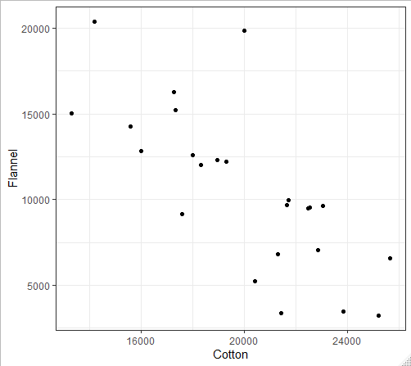
Pearson Product Moment Correlation

Slide 19
Spearman Rank Correlation
Eventually, we’re going to be simulating demands for cotton and flannel pajamas, following the distributions we determined in the previous section. However, since they follow different distributions, and since Pearson correlation measures the strength of the linear relationship between them, the Pearson correlation can only go so high. To account for this, we use the Spearman correlation instead.

Slide 20
Spearman Rank Correlation
The Spearman correlation takes the intermediate step of calculating the rank of each observation in the data frame, then computing the Pearson correlation of those ranks. If these ranks match up perfectly, you could observe a Spearman correlation of 1, when the Pearson correlation would not achieve that result. In other words, Spearman correlation allows us to generate correlated values from different probability distributions.

Slide 21
Spearman Rank Correlation
We compute the Spearman correlation using the “method” argument within the cor function, as displayed in Figure 6.9.

Slide 22
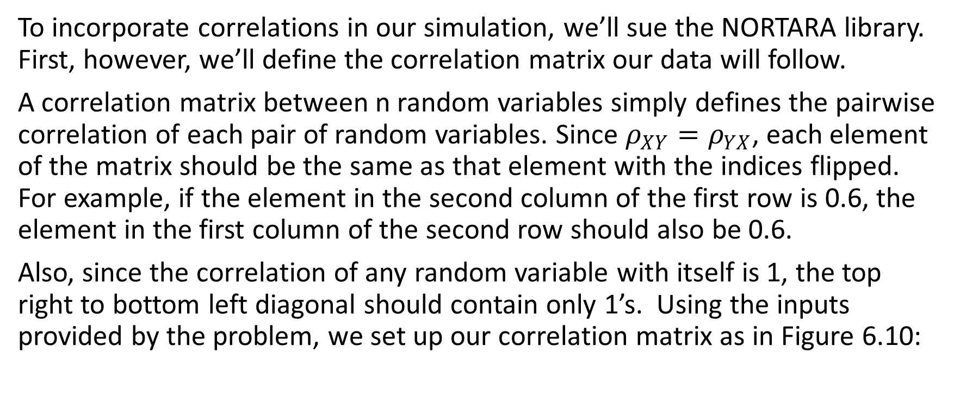
Setting Up a Correlation Matrix in R
To incorporate correlations in our simulation, we’ll sue the NORTARA library. First, however, we’ll define the correlation matrix our data will follow.
A correlation matrix between n random variables simply defines the pairwise correlation of each pair of random variables. Since $ρ_{XY}=ρ_{YX}$, each element of the matrix should be the same as that element with the indices flipped. For example, if the element in the second column of the first row is 0.6, the element in the first column of the second row should also be 0.6.
Also, since the correlation of any random variable with itself is 1, the top right to bottom left diagonal should contain only 1’s. Using the inputs provided by the problem, we set up our correlation matrix as in Figure 6.10:

Slide 23

Setting Up a Correlation Matrix in R
The matrix function takes a vector of numbers, a number of rows, and a number of columns, and returns a matrix of those dimensions. If we’re careful spacing the vector, it makes it very easy to see what element will go where in our matrix.
Unfortunately, even if we follow the specifications listed above, we may not have a valid correlation matrix. For example, if a matrix were as follows:

Slide 24
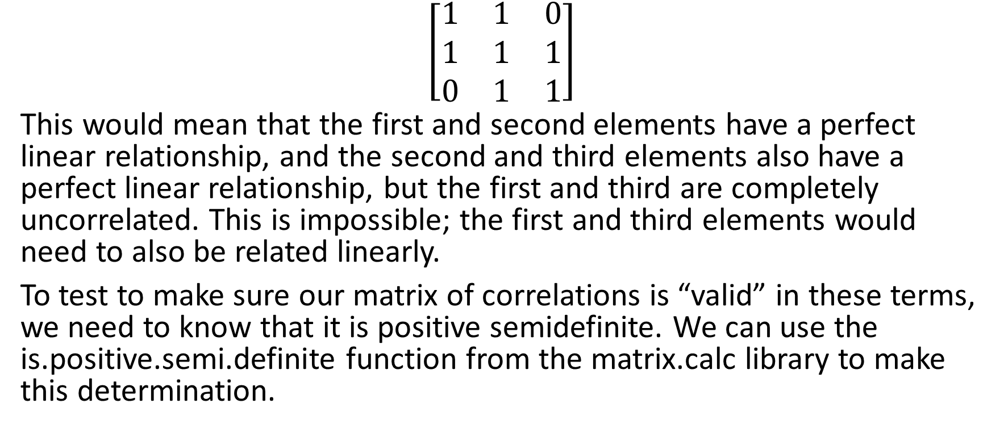
Setting Up a Correlation Matrix in R
$$\left[\begin{matrix}1 & 1 & 0 \\ 1 & 1 & 1 \\ 0 & 1 & 1\end{matrix}\right]$$
This would mean that the first and second elements have a perfect linear relationship, and the second and third elements also have a perfect linear relationship, but the first and third are completely uncorrelated. This is impossible; the first and third elements would need to also be related linearly.
To test to make sure our matrix of correlations is “valid” in these terms, we need to know that it is positive semidefinite. We can use the is.positive.semi.definite function from the matrix.calc library to make this determination.

Slide 25
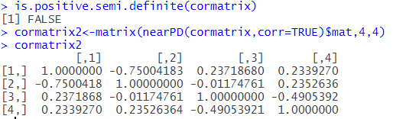
Setting Up a Correlation Matrix in R
If it is not, we can adjust it using the nearPD function from the Matrix library, which adjusts the values in the matrix as little as possible to get a positive semidefinite matrix. The code and results can be seen in Figure 6.11.

Slide 26
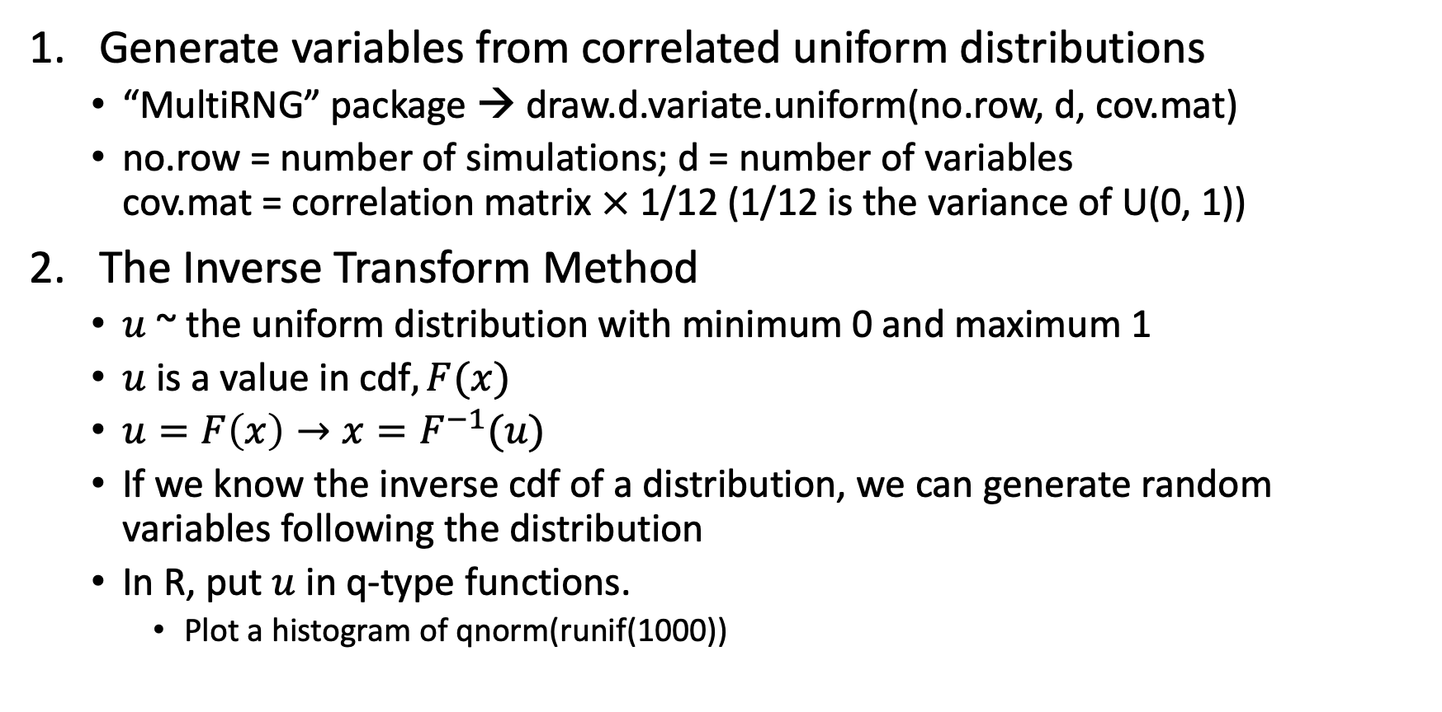
Building the Correlated Model
Generate variables from correlated uniform distributions
“MultiRNG” package → draw.d.variate.uniform(no.row, d, cov.mat)
no.row = number of simulations; d = number of variables cov.mat = correlation matrix $×$ 1/12 (1/12 is the variance of U(0, 1))
The Inverse Transform Method
$u$ ~ the uniform distribution with minimum 0 and maximum 1
$u$ is a value in cdf$, F(x)$
$u=F\left(x\right)→x=F^{−1}(u)$
If we know the inverse cdf of a distribution, we can generate random variables following the distribution
In R, put $u$ in q-type functions.
Plot a histogram of qnorm(runif(1000))

Slide 27
Building the Correlated Model
For cotton and flannel demand, this is no problem; we have the qnorm and qweibull functions from R. For the velour pajamas, we’ve already written an rtri function, so we just use the same function without the sapply to create qtri.
For the silk pajamas, we still need to come up with the inverse cdf function. Without getting into too many details, we start with the density function, integrate, then take the inverse of the result. Fortunately, the density function silk pajamas was piece-wise constant, so this is fairly easy to do.
The inverse cdfs for the triangular distribution and our specific silk pajama density are provided in Figure 6.12, along with a histogram of randomly generated silk pajamas to make sure the function works as intended.

Slide 28
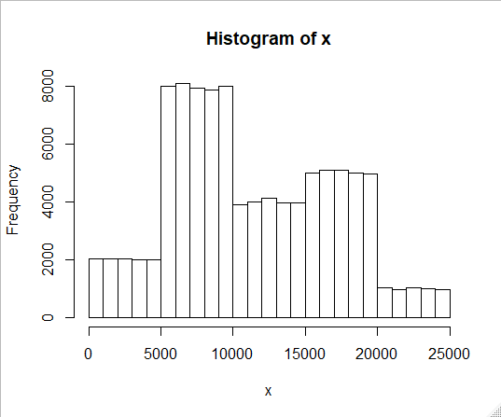
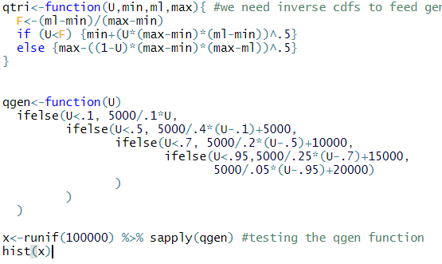
Building the Correlated Model

Slide 29
Building and checking the Correlated Model
df <- data.frame(draw.d.variate.uniform(10000, 4, cormatrix2))
colnames(df) <- c("demC", "demF", "demS", "demV")
df$demC <- qnorm(df$demC, cmodel$estimate[1], cmodel$estimate[2])
df$demF <- qweibull(df$demF, fmodel$estimate[1], fmodel$estimate[2])
df$demS <- sapply(df$demS, qgen)
df$demV <- qtri(df$demV, 2500, 10000, 25000)
To determine whether our data is correlated correctly, we calculate the Spearman correlations. We also generate scatter plots of each input against each other input to try an eyeball test. Finally, we plot each marginal density to make sure the data follows their original distributions as well.

Slide 30
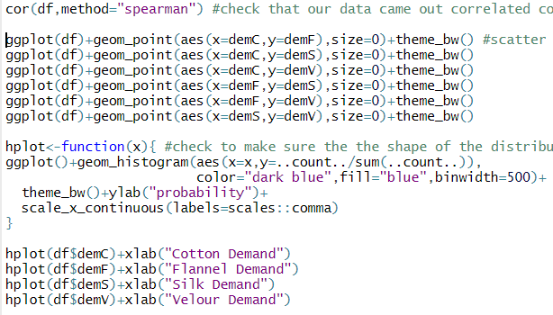

Checking The Input Model

Slide 31
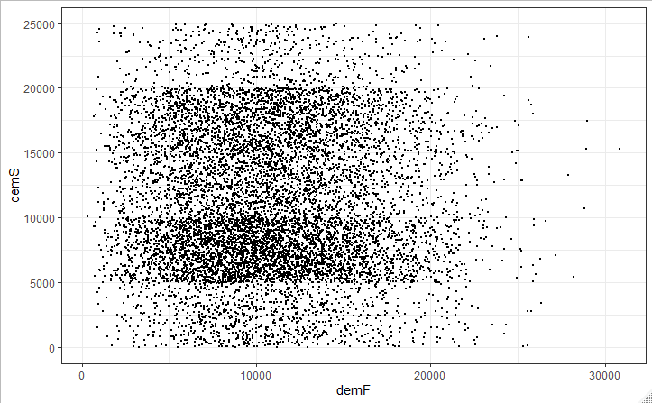
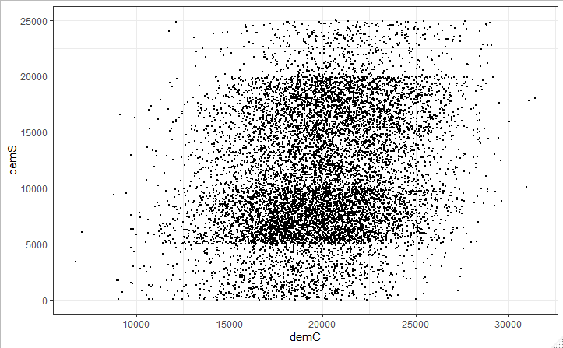
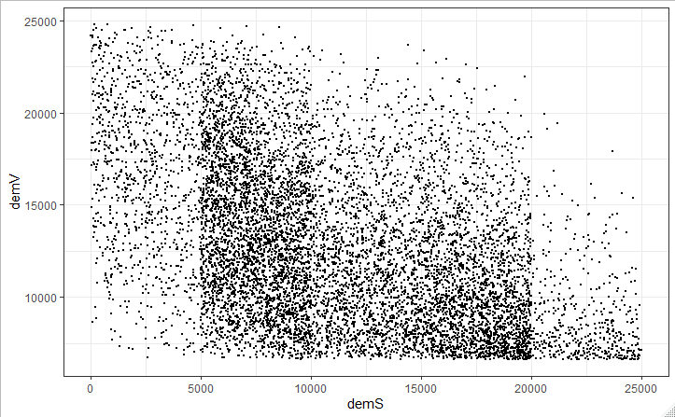
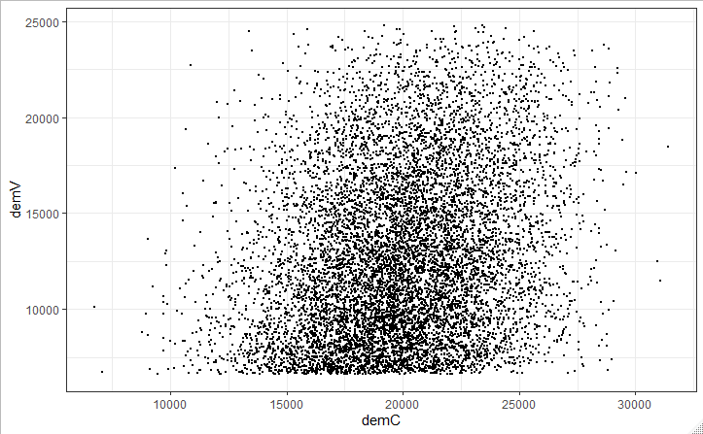
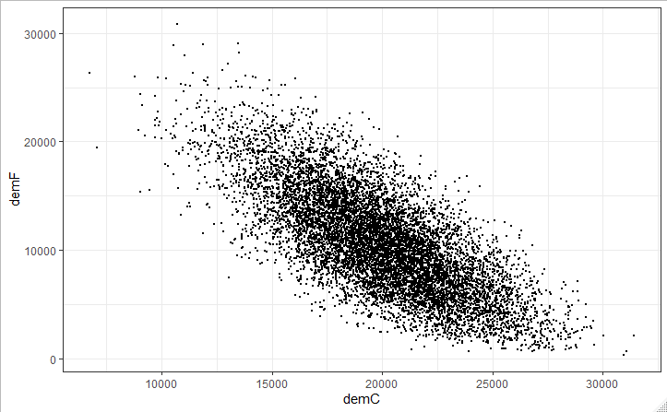
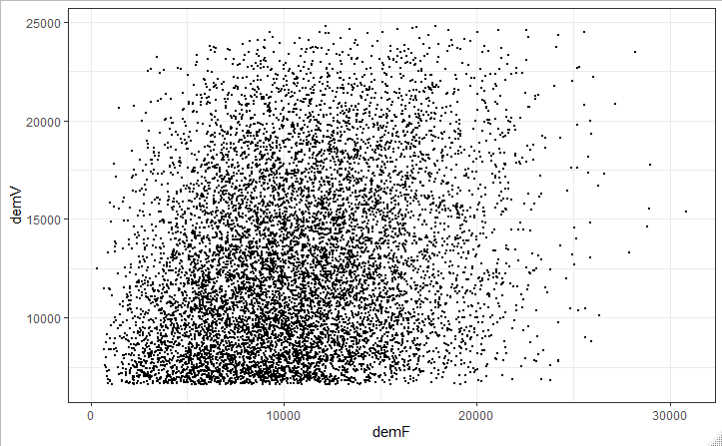
Checking The Input Model

Slide 32
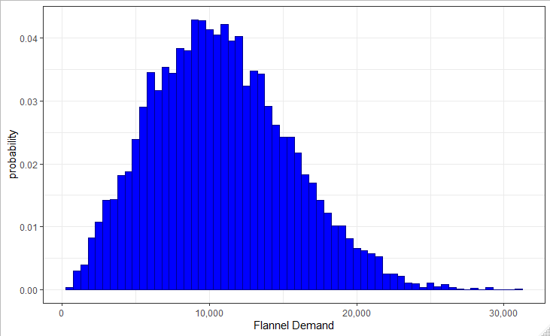
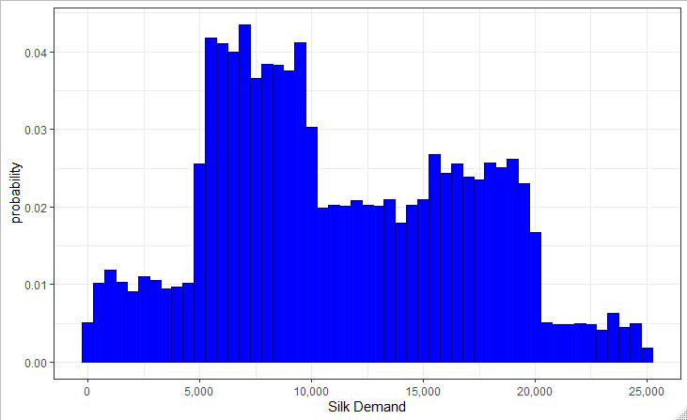
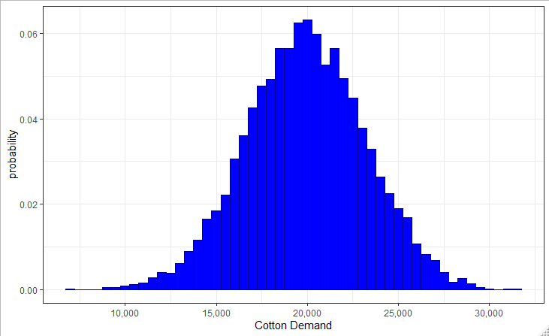
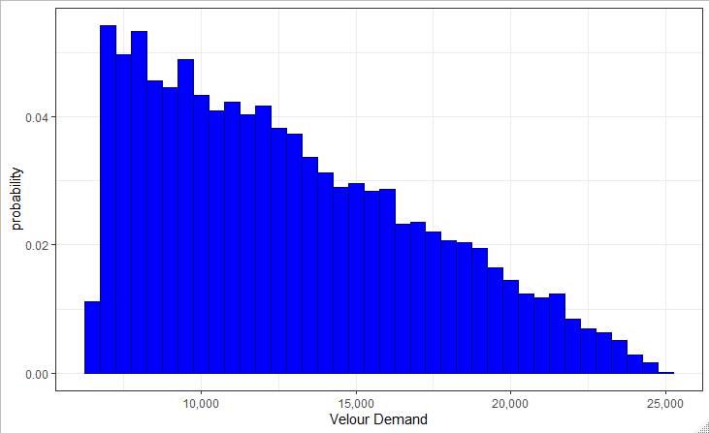

Slide 33
Checking The Input Model
The remaining code is exactly the same as it was in the uncorrelated case: we create an output vector of profits in order to study the resulting distribution.
Upon running the correlated simulation, I find a mean profit of $582,000 with a standard deviation of $101,000. Running the uncorrelated version, I find a mean profit of $575,000 with a standard deviation of $111,000. Although these results are quite similar, there is no guarantee that this will be the case.
INDIVIDUAL EXERCISE:
Run the correlated and uncorrelated simulations again, only set the order quantity to 20,000 for each product. Do you still observe a similar result between the two? If there’s a difference, how do you account for it?

Slide 34
Lecture 6 References
Camm et al., Essentials of Business Analytics, 2015, Cengage Learning

Slide 35
Lecture 6 Summary Questions
What are the differences between Pearson product moment correlation and Spearman rank correlation?
Why use Spearman rank correlation instead of Pearson product moment correlation?
Please comment on the following statement "It is always a good idea to use the probability with the lowest fit statistic to model an uncertain variable of interest."
What is the purpose of validating a correlation matrix?
Please comment on the following statement: "It is recommended to take correlations into account when building a simulation model if there is any evidence of correlation among uncertain inputs."

